Slide 1
Printing the Future Course: “3d Printing- Fostering creativity in your students”
Athens
Erasmus + KA1 BET.IN.BAS
25 March – 2 April

Slide 2
I.C. “Lorenzo Milani” POLICORO
Prof. LAGUARDIA ANTONIO
Prof. CUCCARESE ROSALIA
I.C. “Enrico Fermi” MATERA
Prof. MICCIANTUONO GISELLA

Slide 3
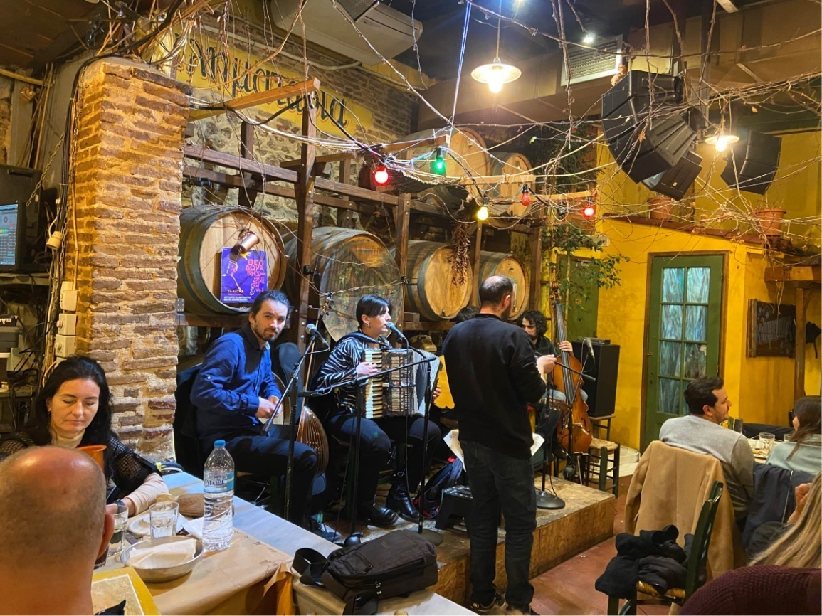
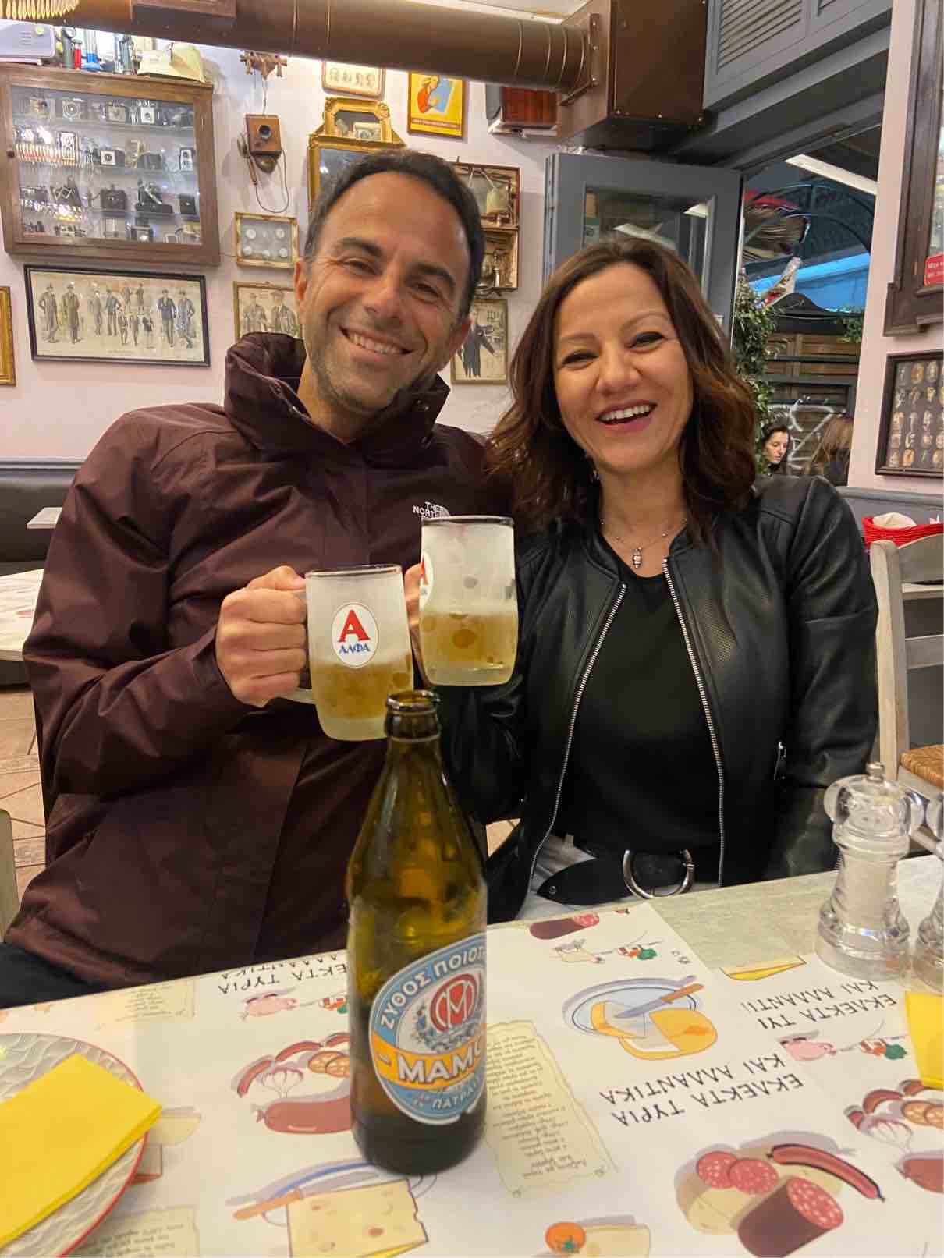
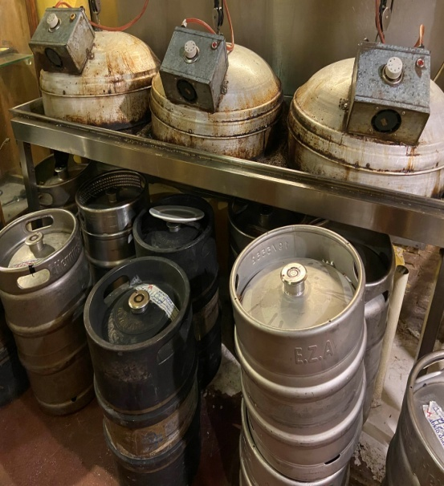
WELCOME TO
A
T
H
E
N
S

Slide 4
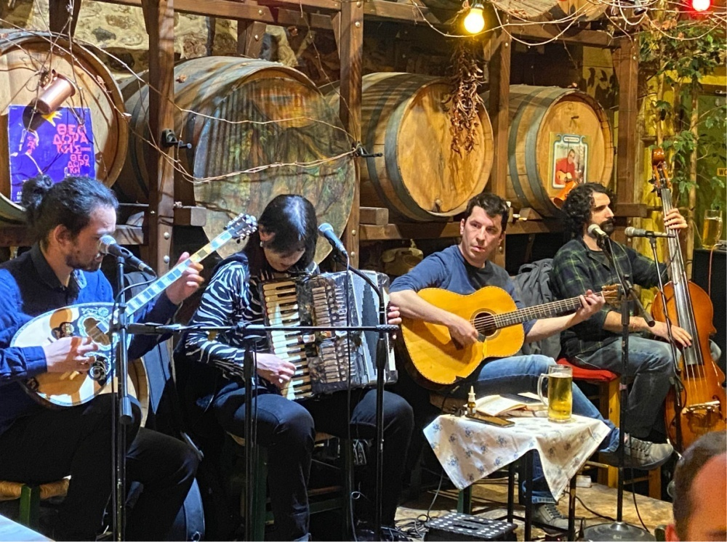
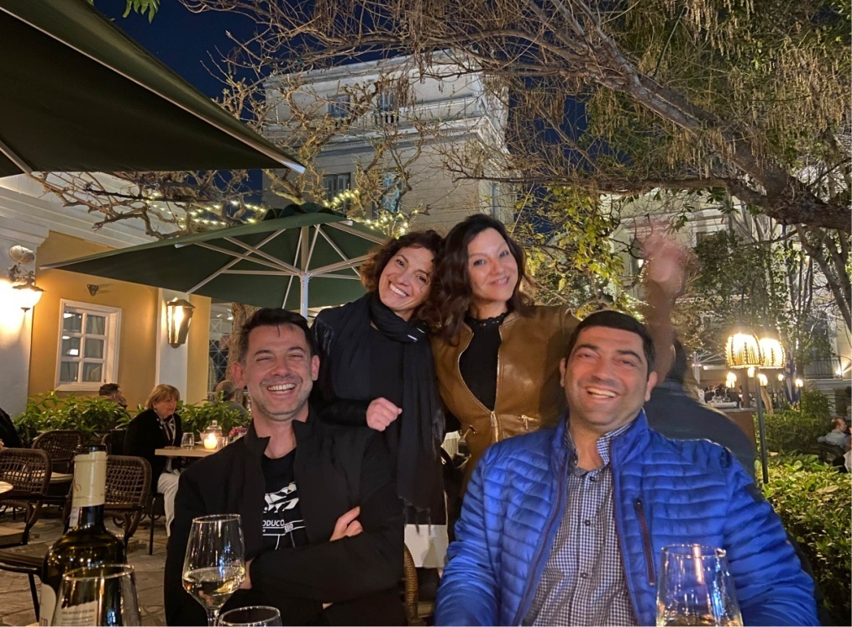

Slide 5
A
C
R
O
P
O
L
I
s

Slide 6
Athens, yes or not?

Slide 7
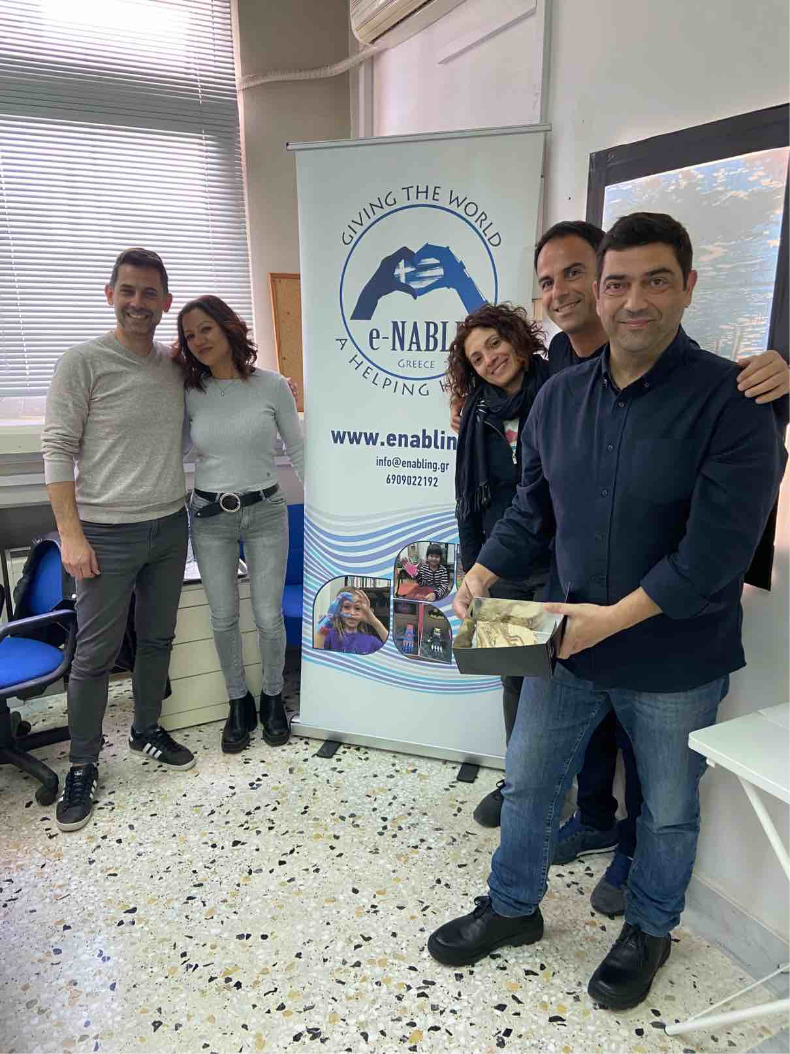
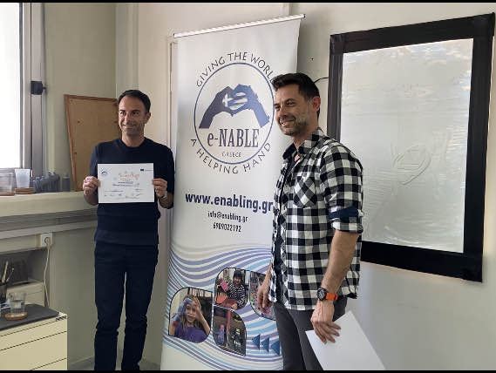
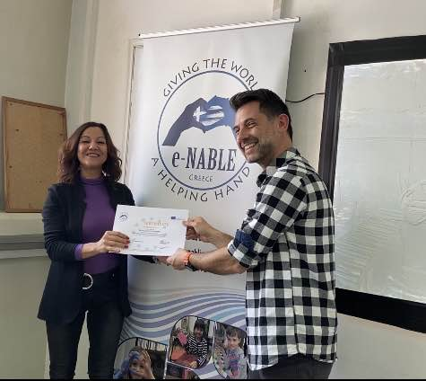
National Technical University of Athens

Slide 8
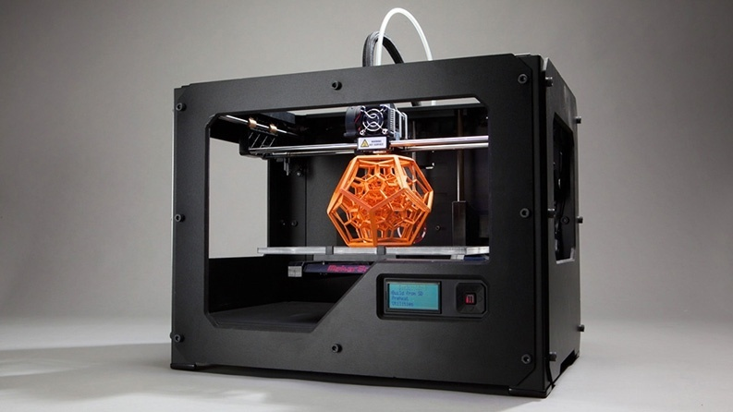
3D PRINTING
3D printing is a technology that allows you to create an object layer by layer starting directly from a model.
It is a revolutionary technology for creating high-quality complex objects, quickly and efficiently, in various materials such as wood, plastic, metals and even food.
Printers have great potential for use in many sectors such as: jewelry, industrial design, medical and dental.

Slide 9
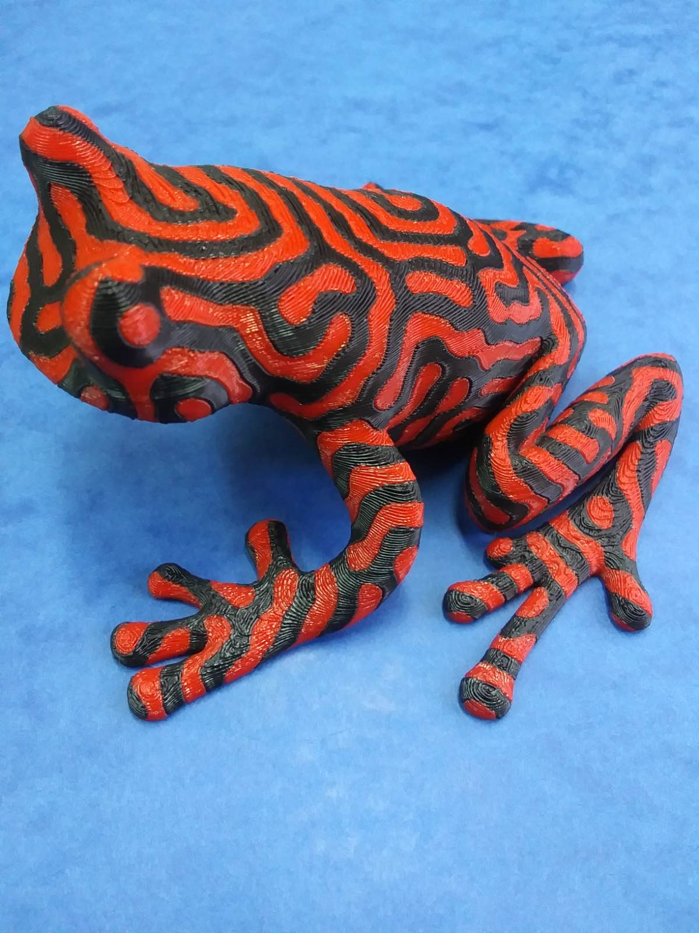
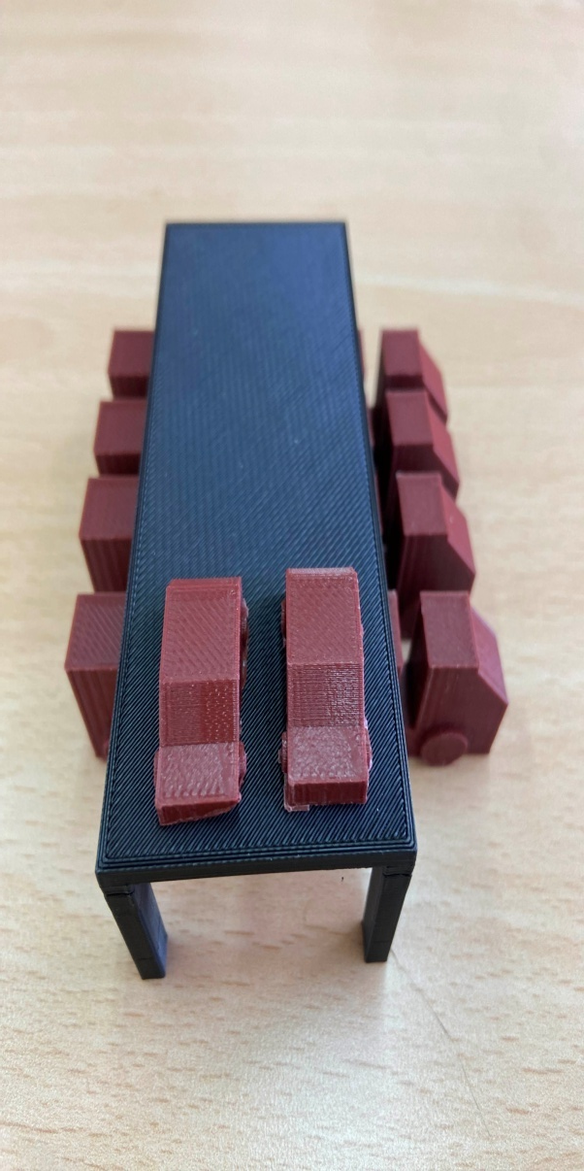
Projects created with the 3D printer

Slide 10
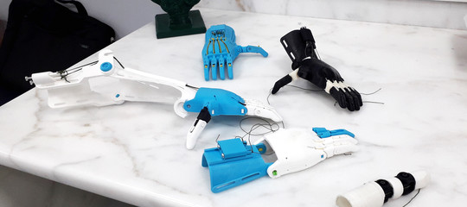

Slide 11
WHAT IS E-NABLE?
e-NABLE is an online global community of approximately 40.000 “Digital Humanitarian” volunteers from all over the world who are using their 3D printers to make free and low-cost prosthetic upper limb devices for children and adults in need.
e-NABLE volunteers help those who were born missing their fingers and hands or who have lost them due to war, natural disaster, illness or accidents.
They works hard to help those in underserved communities who have little to no access to medical care. Volunteers are working hard to “Give the World a Helping Hand”

Slide 12
“We cannot always build the future for our youth, but we can build our youth for the future.” F. D. Roosevelt

