Slide 1
IRELAND Dublin
Erasmus+ BET.IN.BAS
«Intensive General English»
From 5th to 16th June 2023)
Language course

Slide 2
I.C. N1 ’’Lorenzo Milani’’-Policoro (MT) Casalnuovo Rosanna Menegatti Liliana Kindergarten teacher Non-teaching staff
I.C.’’Nicola Sole’’ Senise (PZ)
Spaltro Valeria Golia Cosimo
Kindergarten teacher Non-teaching staff

Slide 3
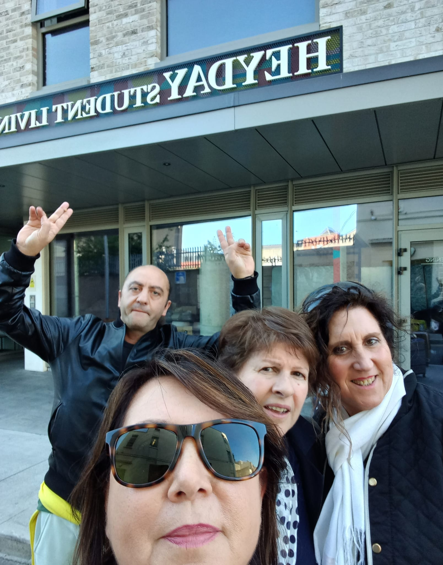
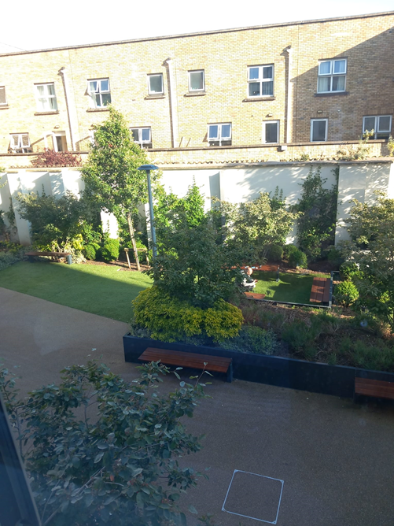
Ready to go

Slide 4
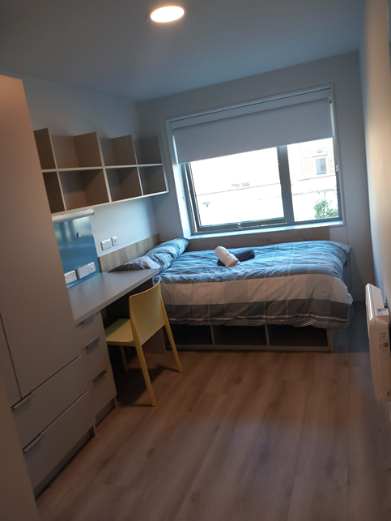
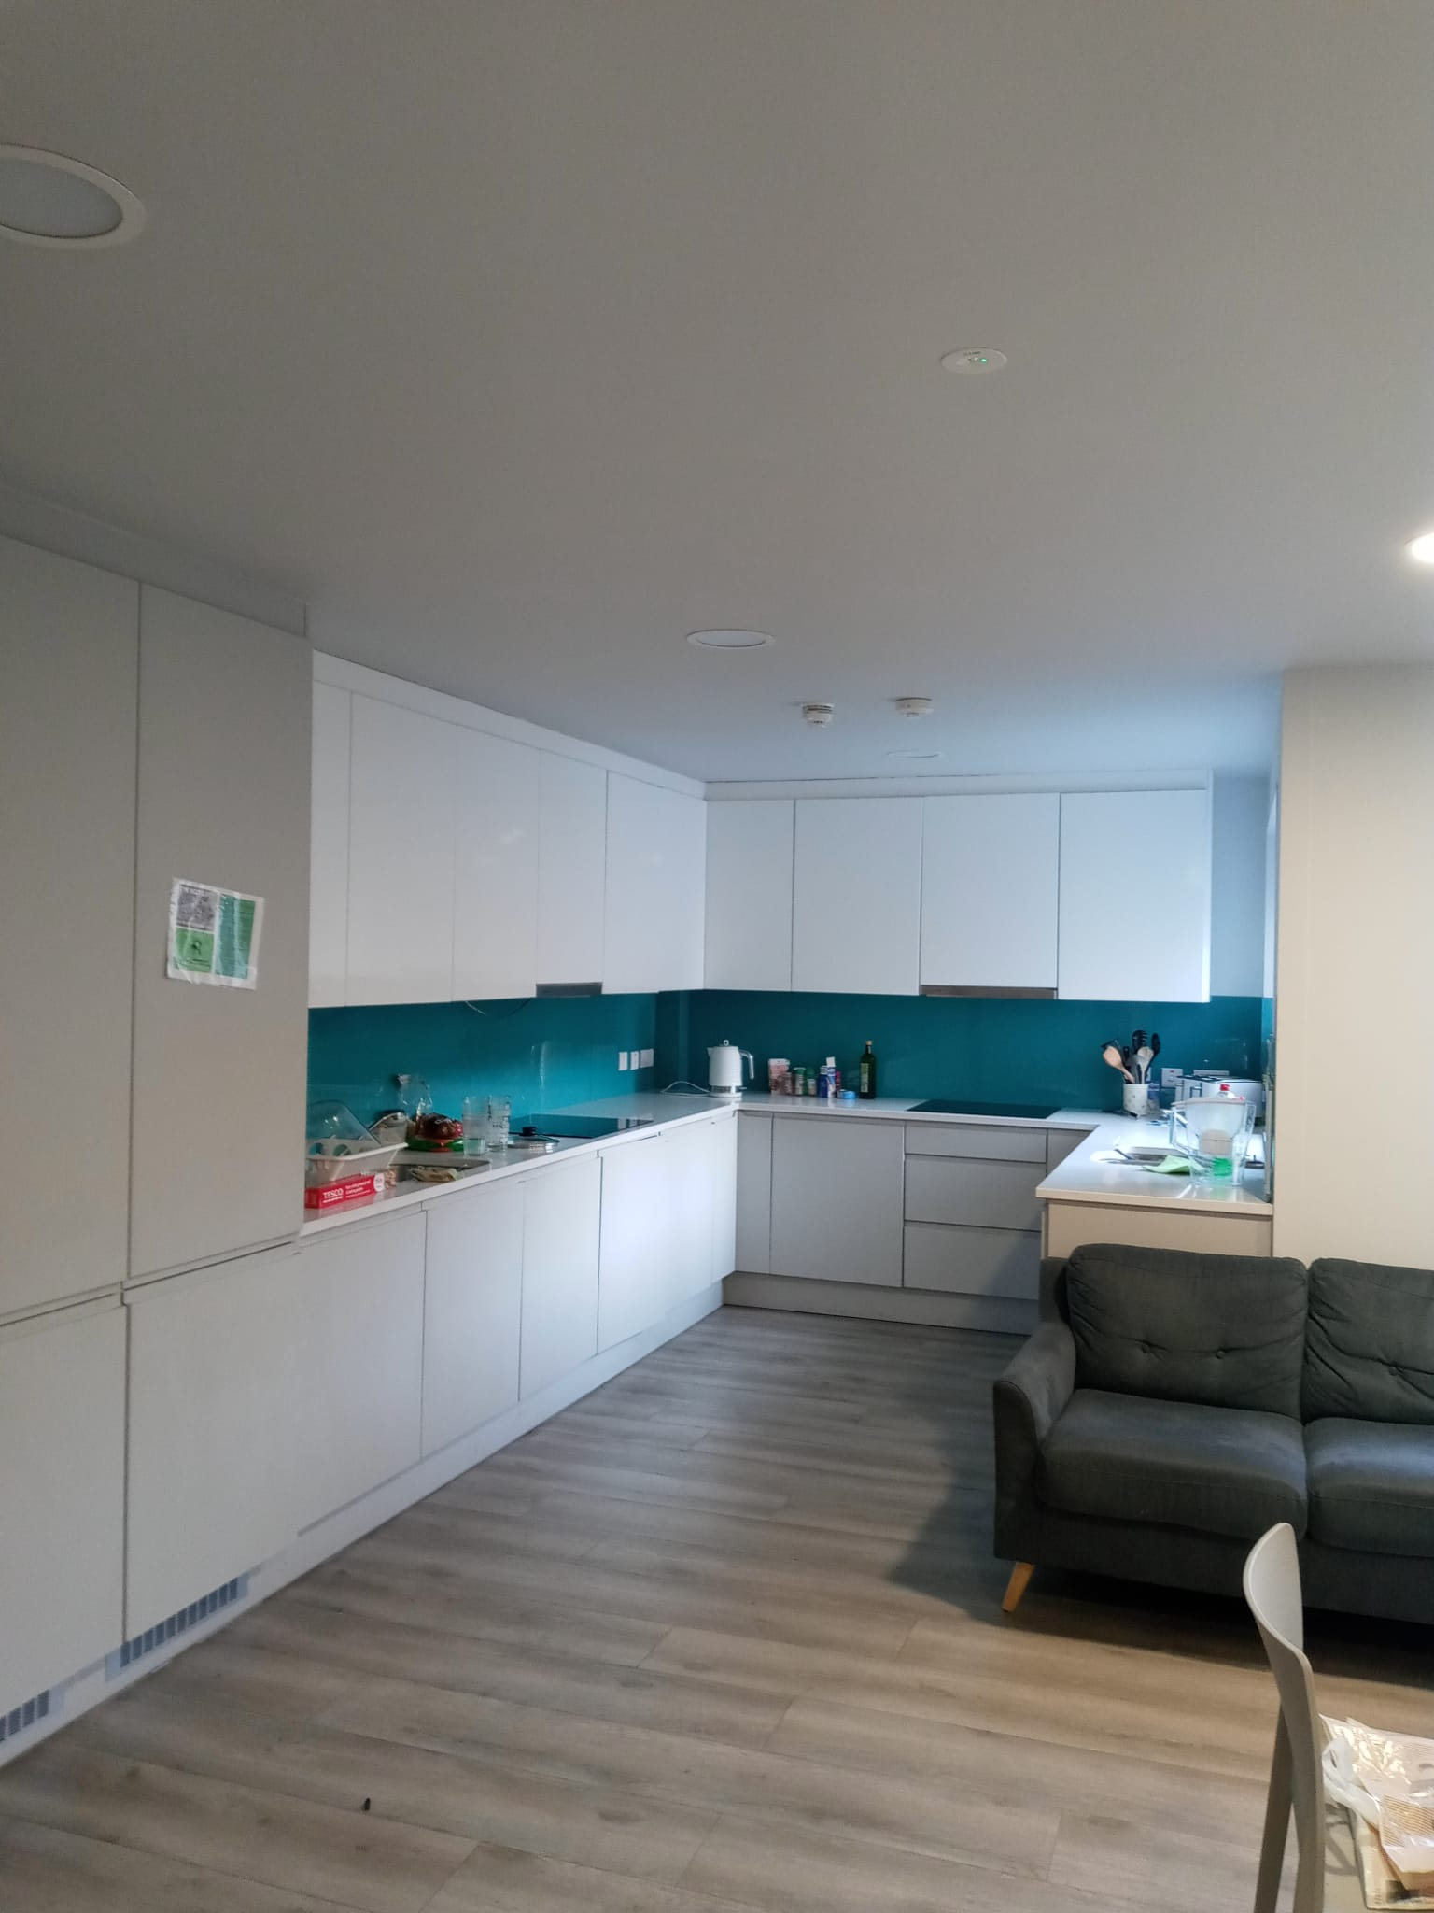
Heyday Student Living: our hotel

Slide 5
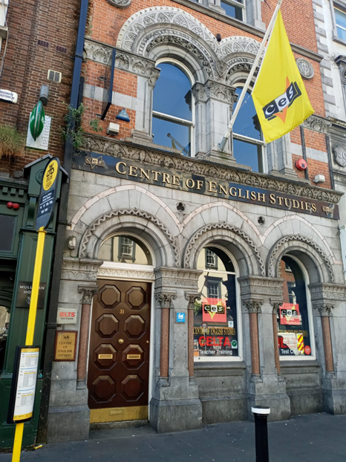
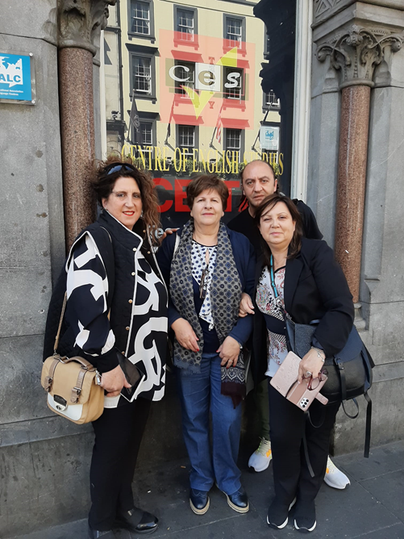
CES: Centre of English Studies

Slide 6
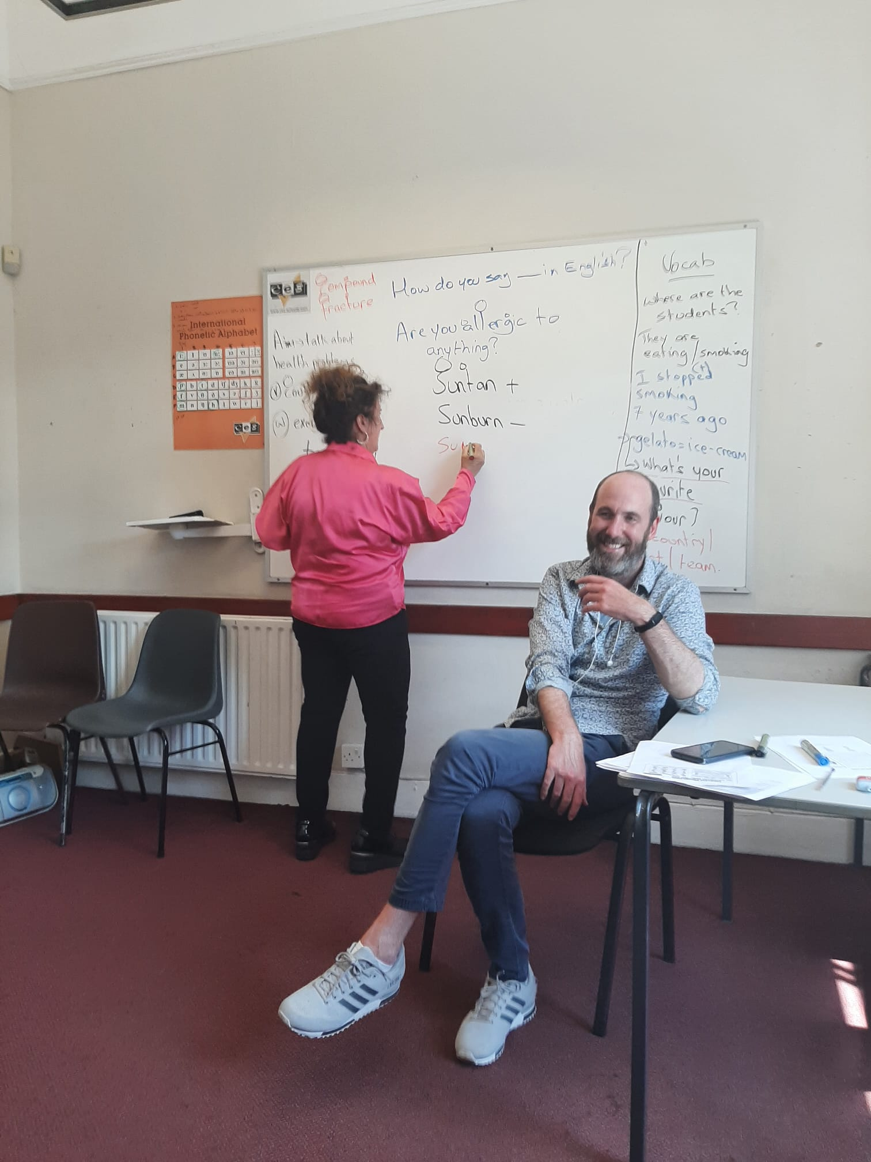
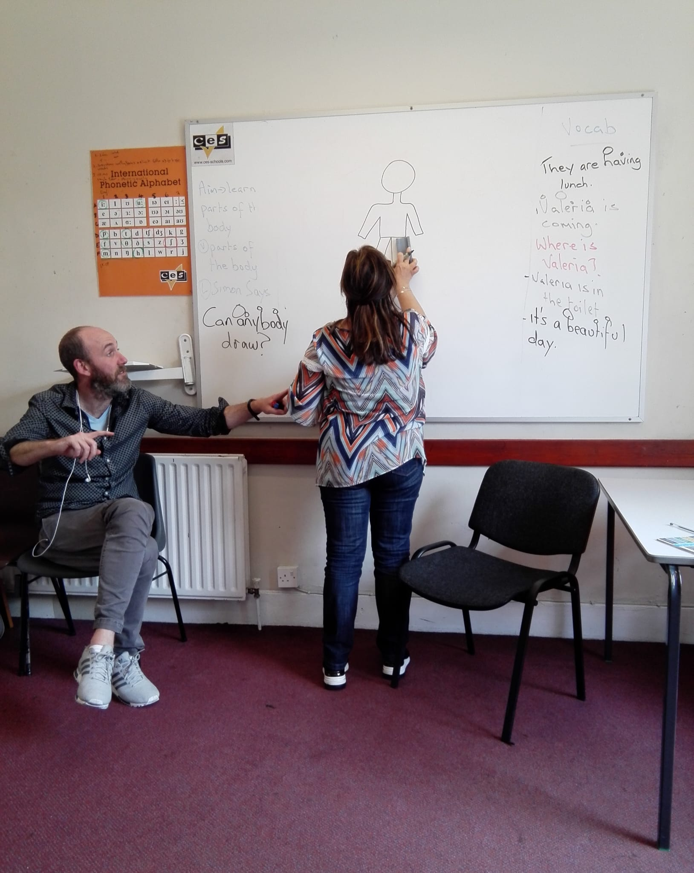
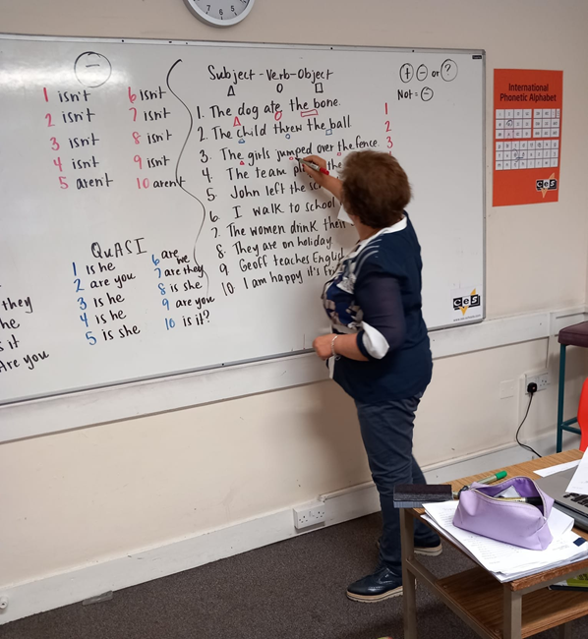
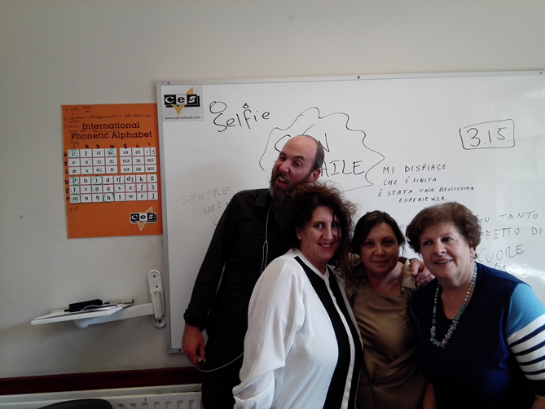
Mr.Garreth’s lesson

Slide 7
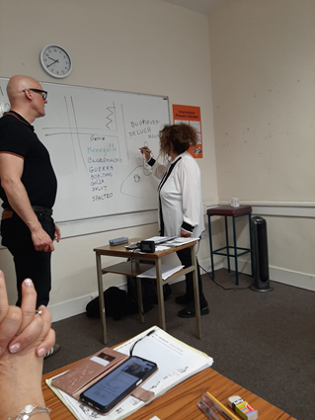
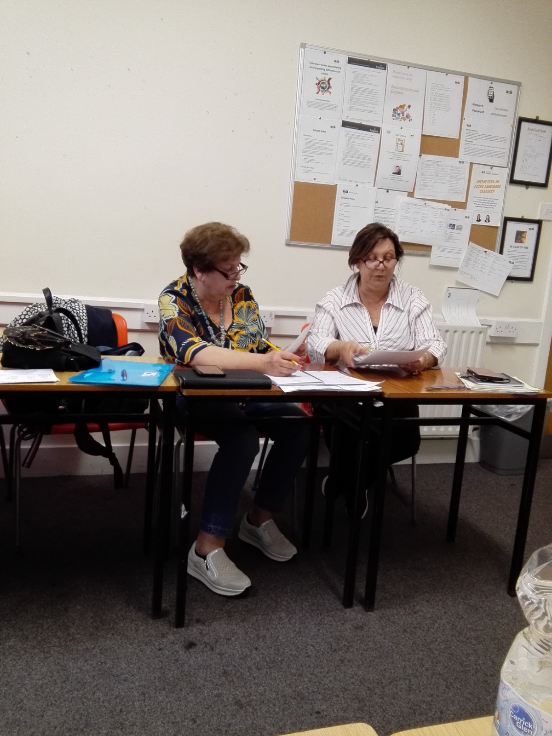
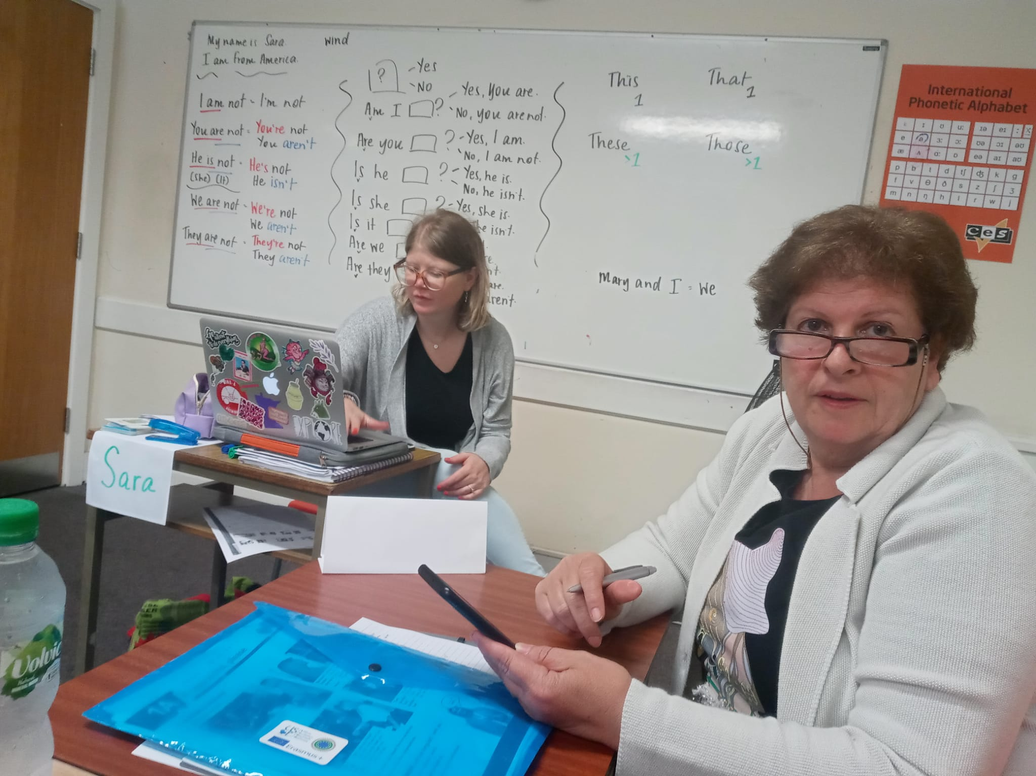
In the classroom: you can speak only English!

Slide 8
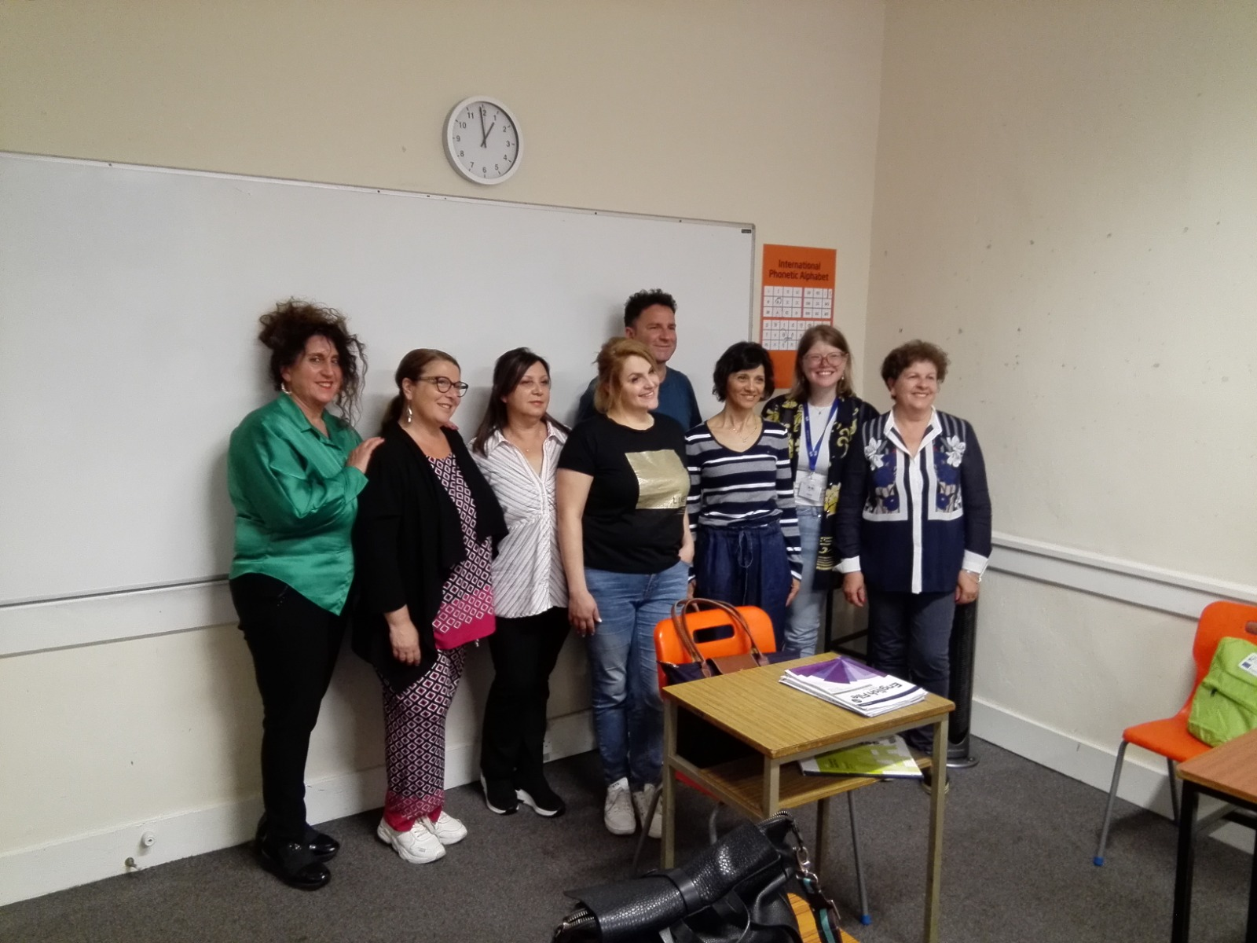
Our classmates

Slide 9
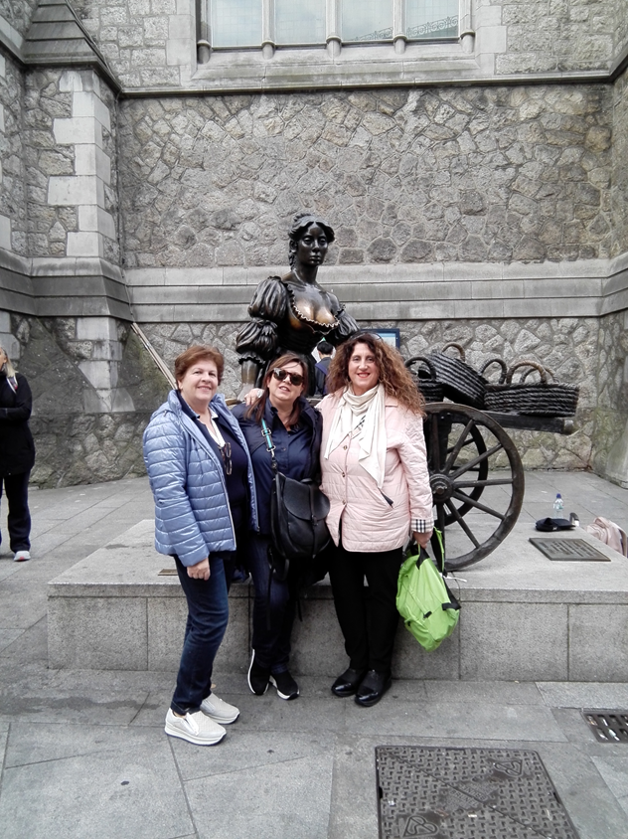
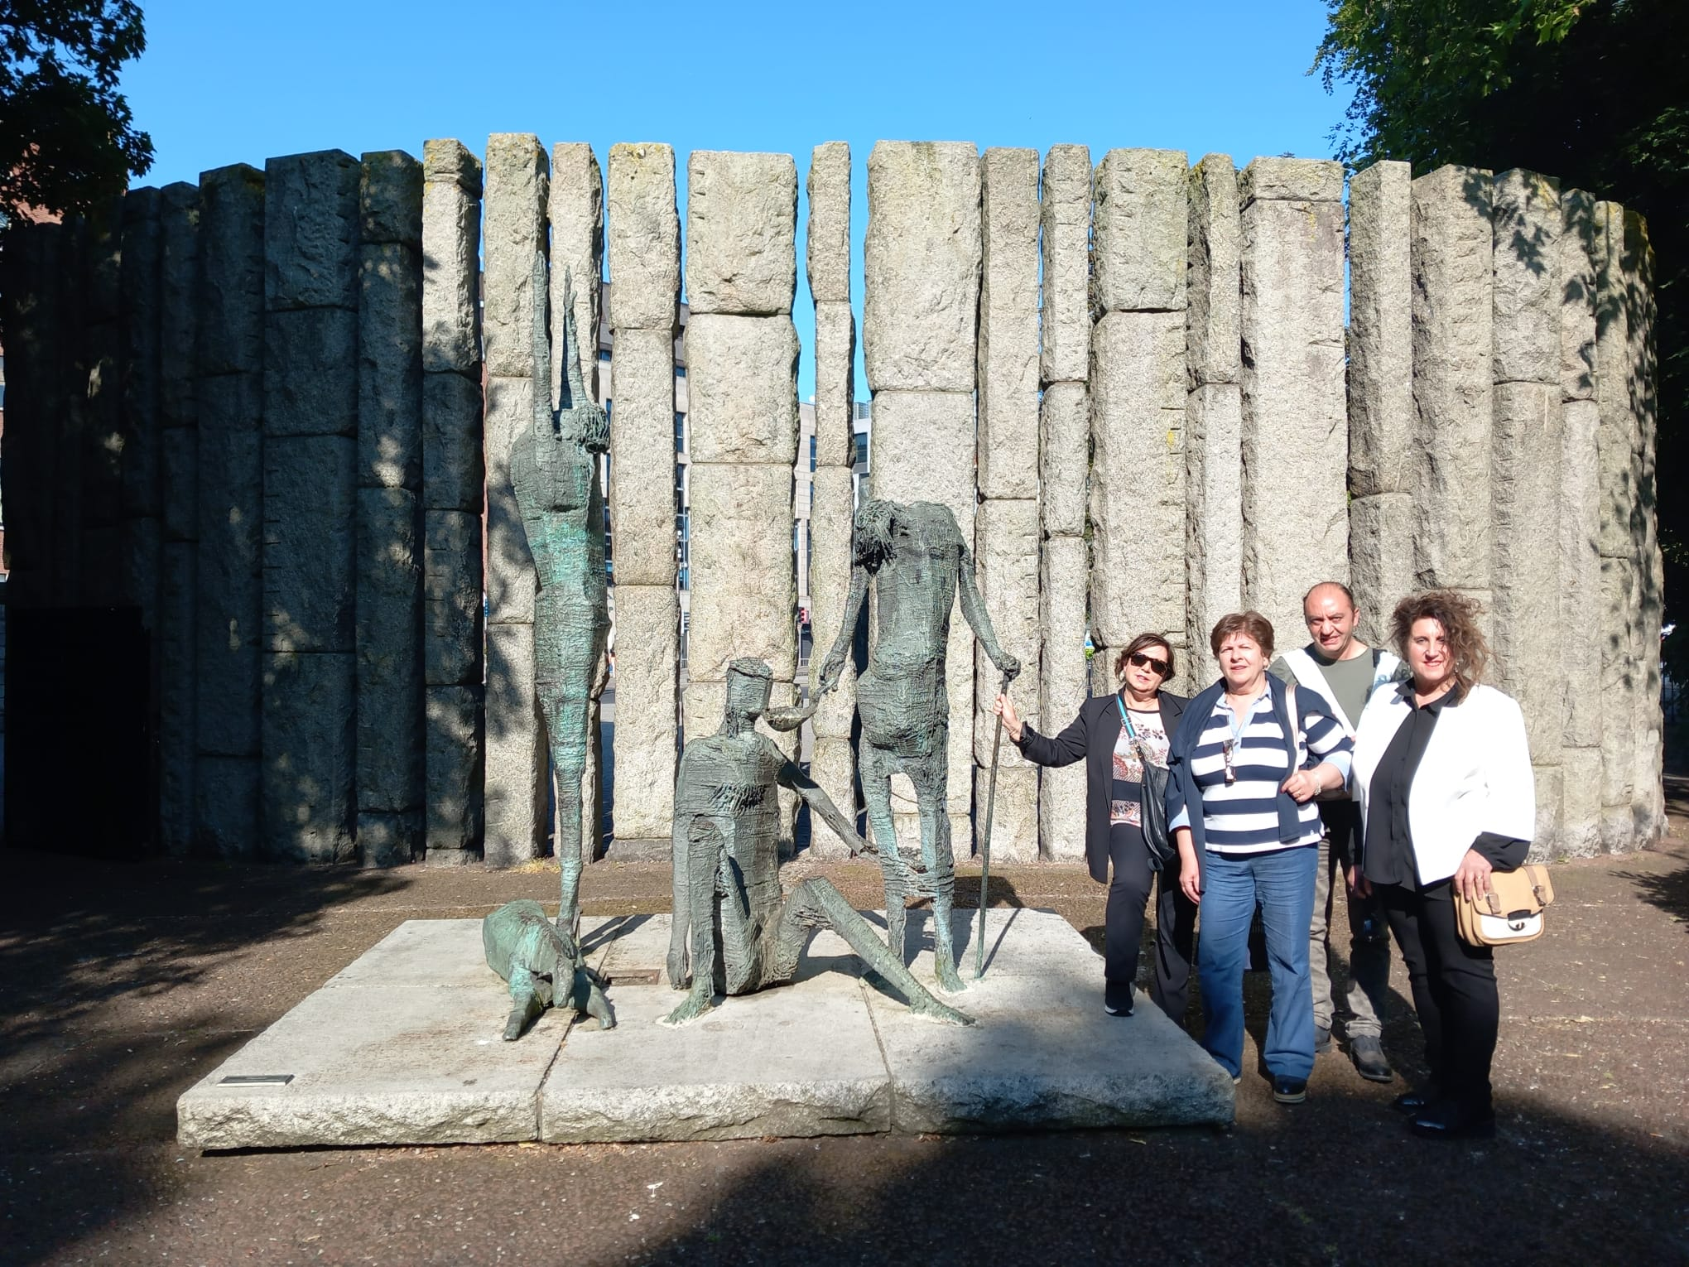
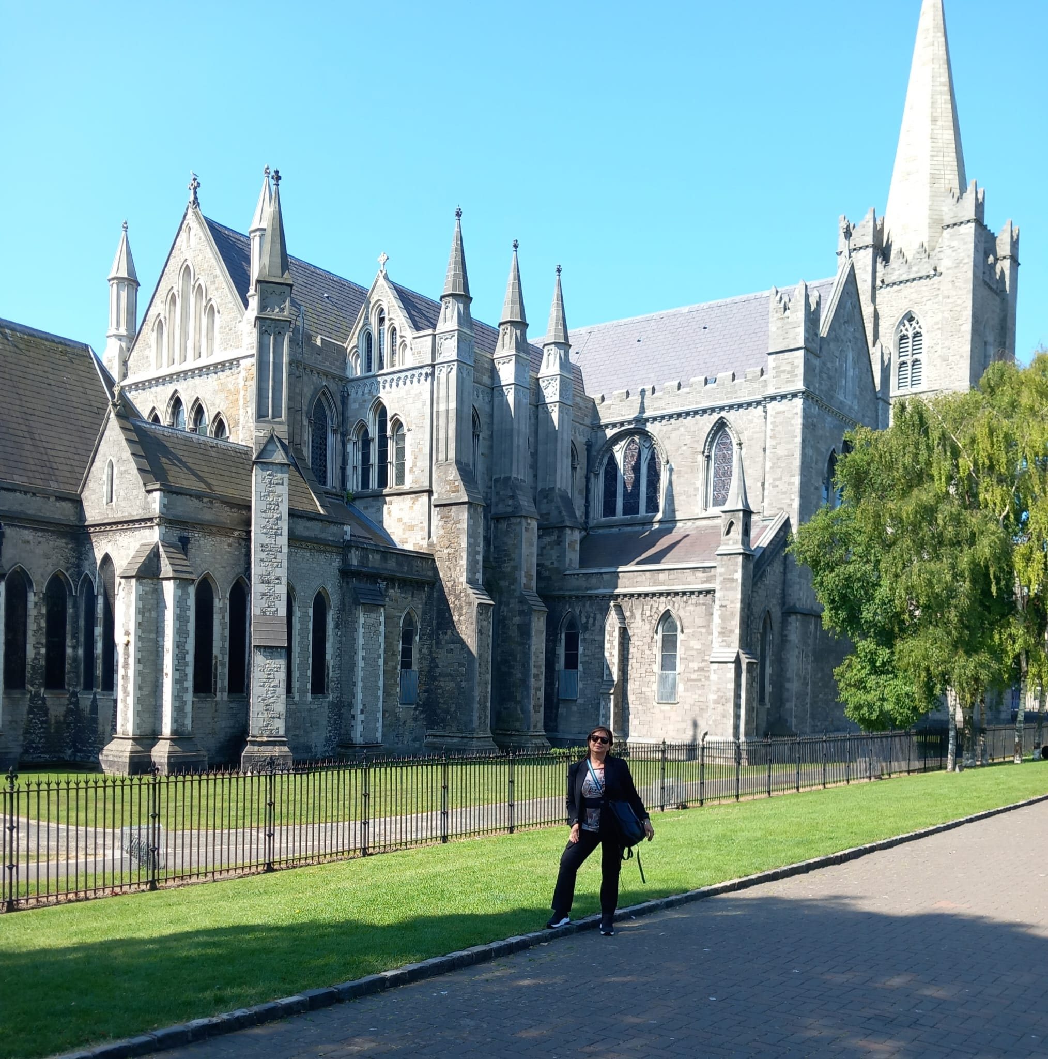
Visit to Dublin
St. Patrick’s Cathedral
St. Stephen’s Green Park
Molly Malone’s statue

Slide 10
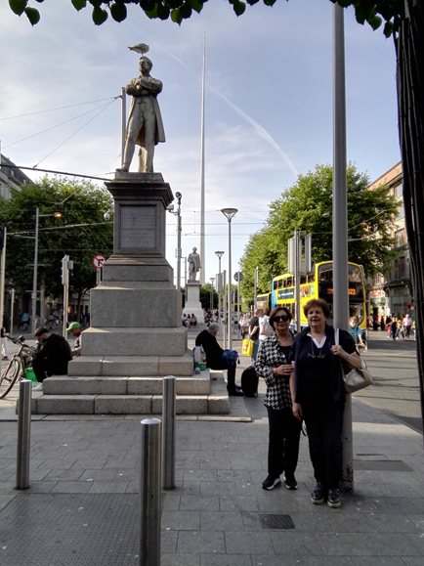
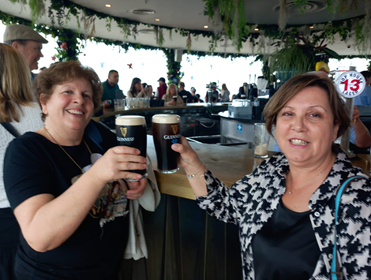
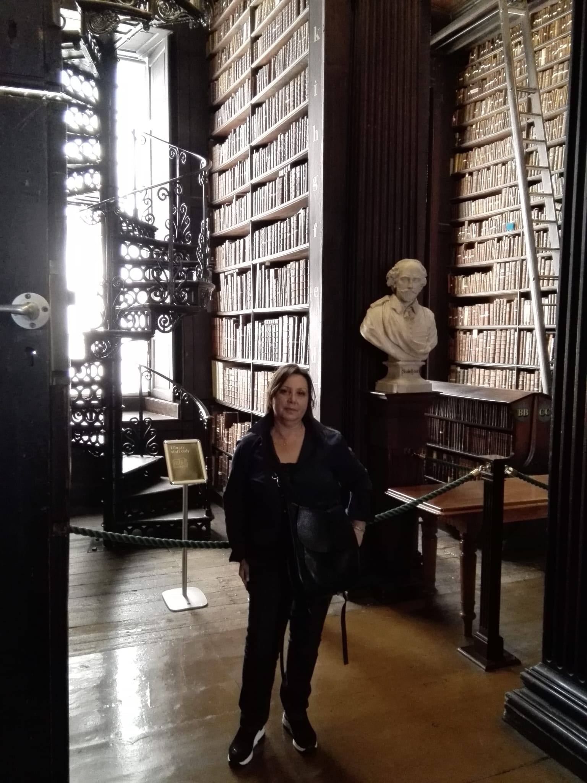
Visit to Dublin
Visit to Guiness
O’ Connell Street
Trinity College

Slide 11
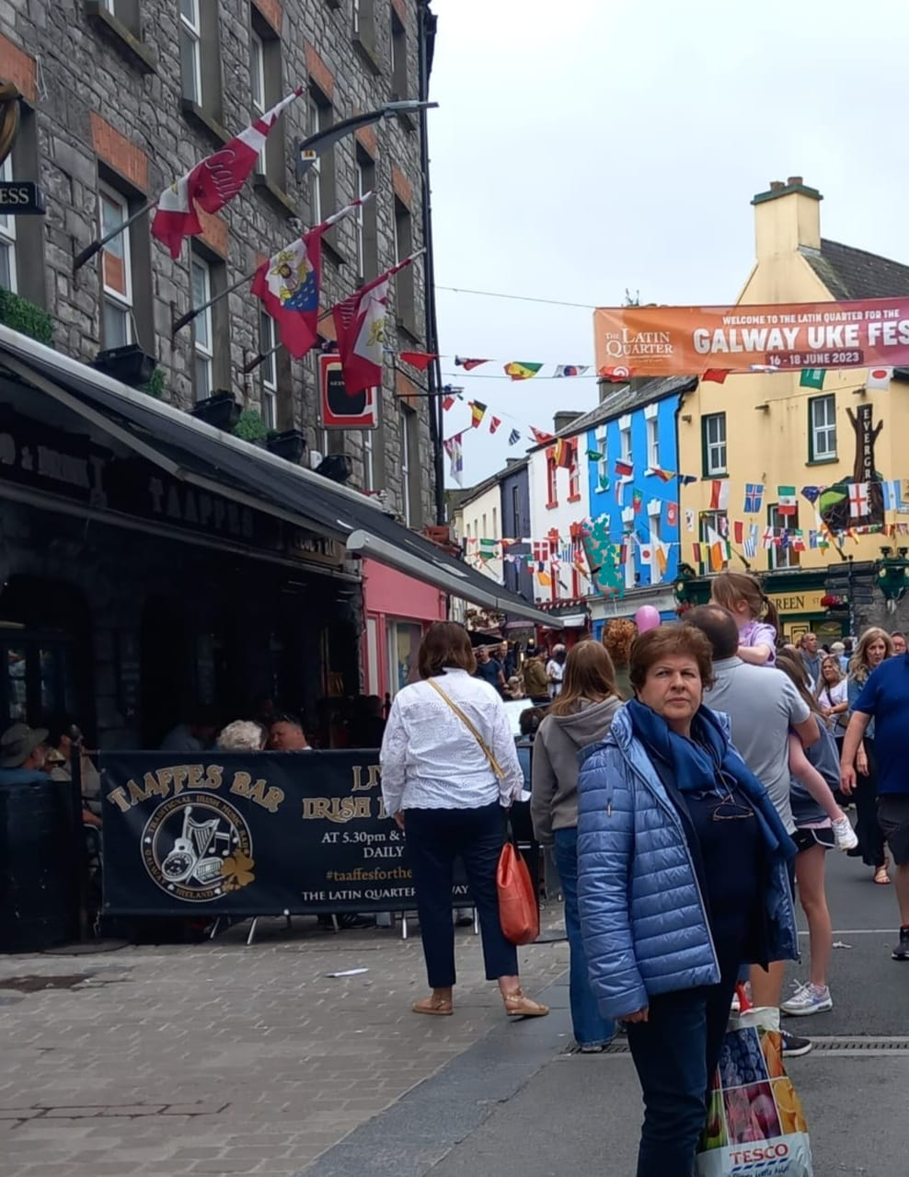
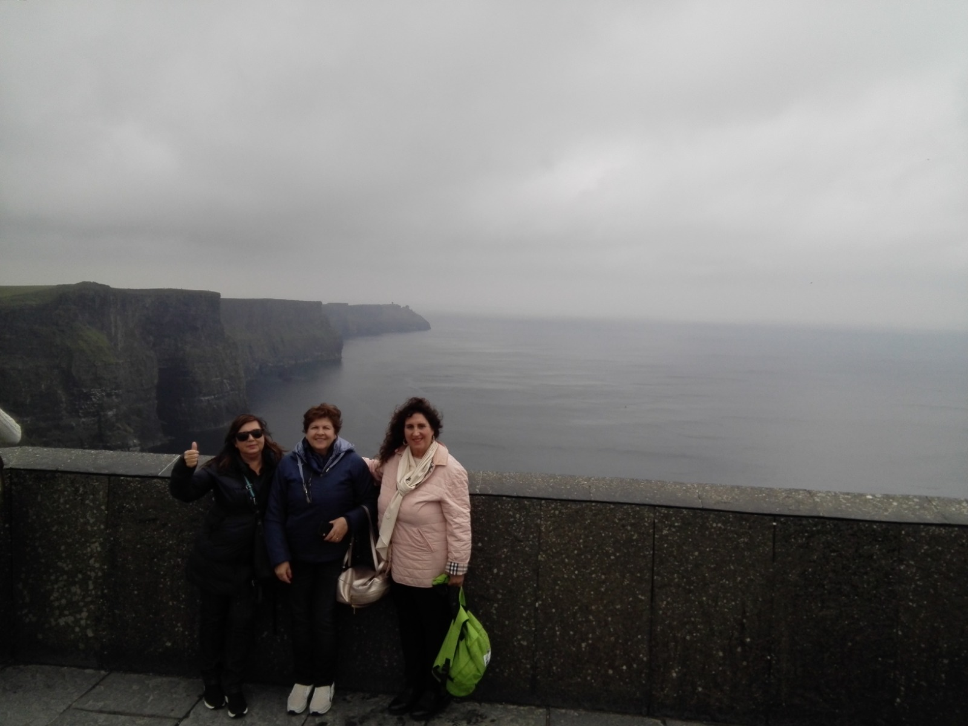
Visiting the Irish beauties
Cliffs of Mother
Galway

Slide 12
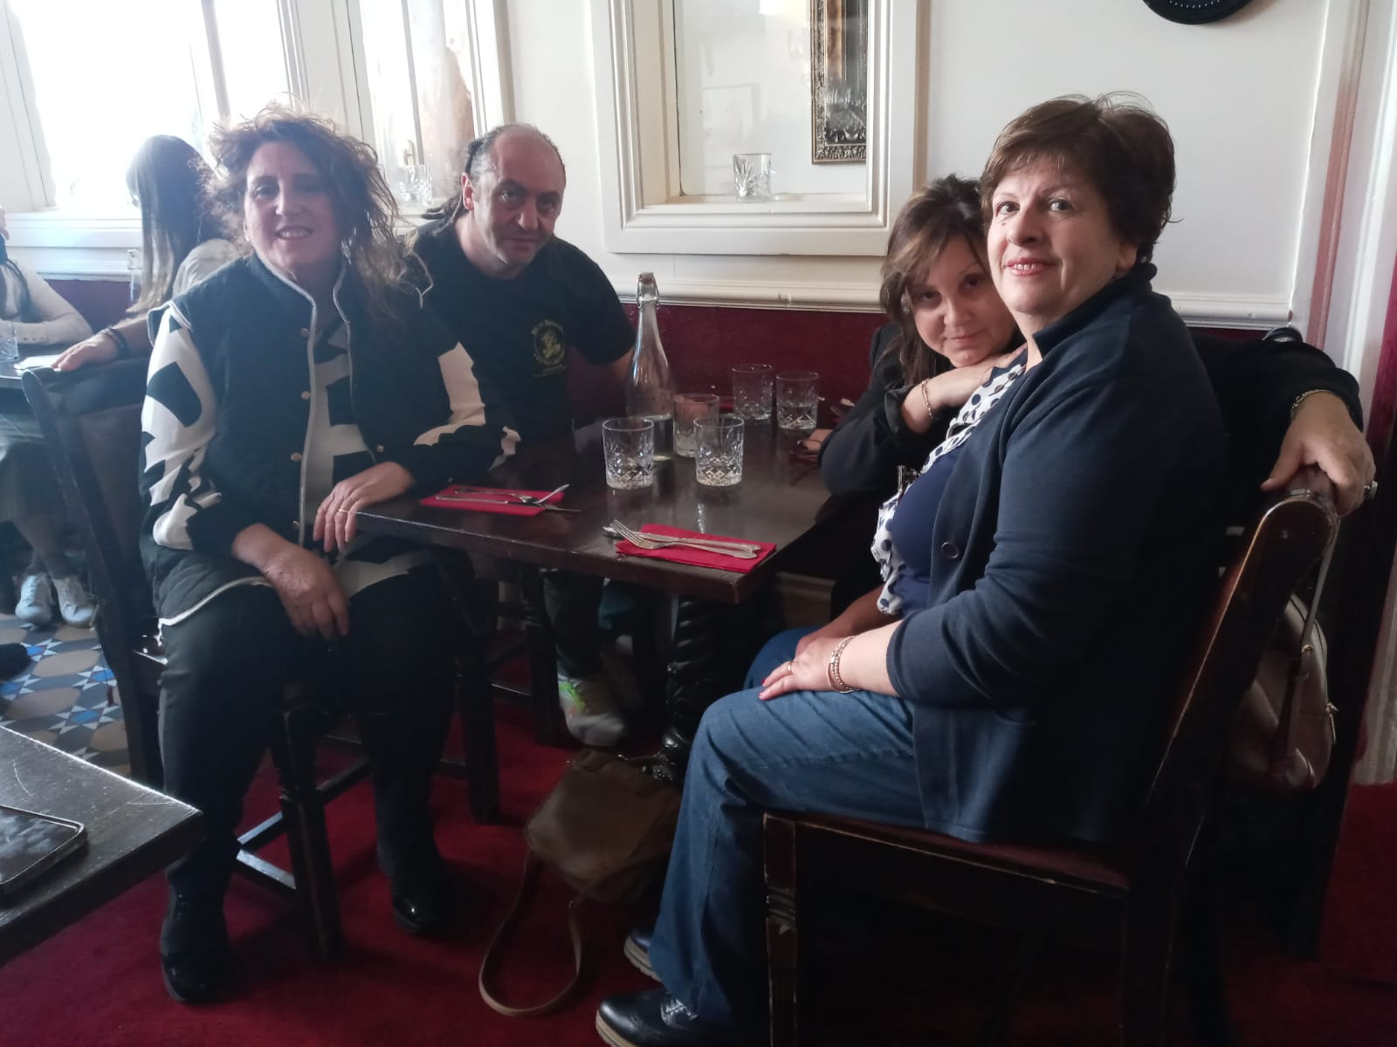
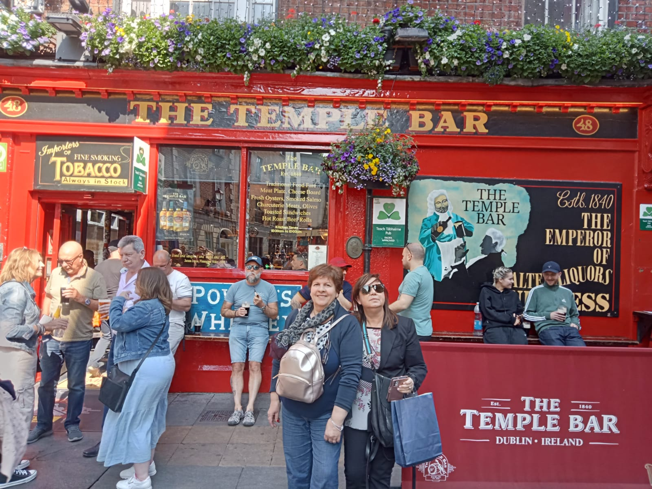
Let’s have a break

Slide 13
IRELAND Dublin
BYE -BYE

